Slide 1
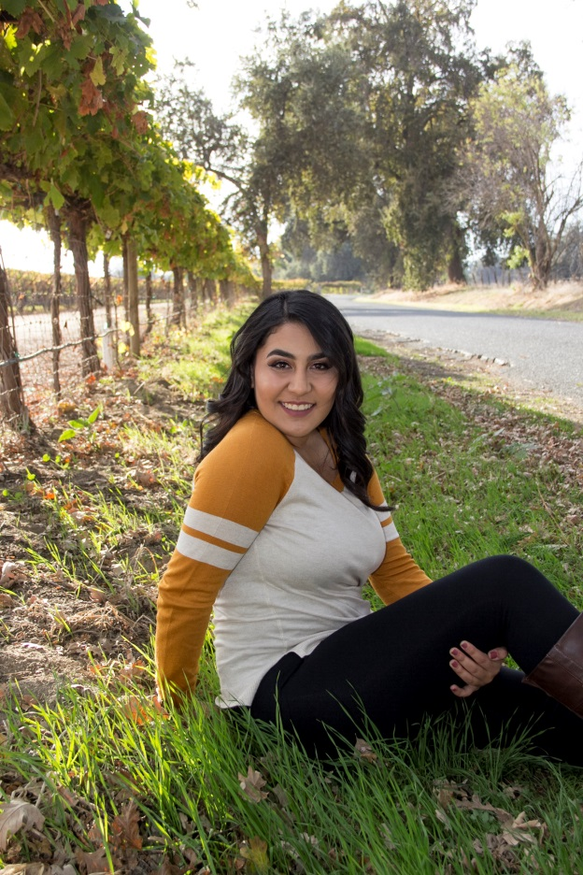
Lyzette Castaneda
C/o 2017

Slide 2
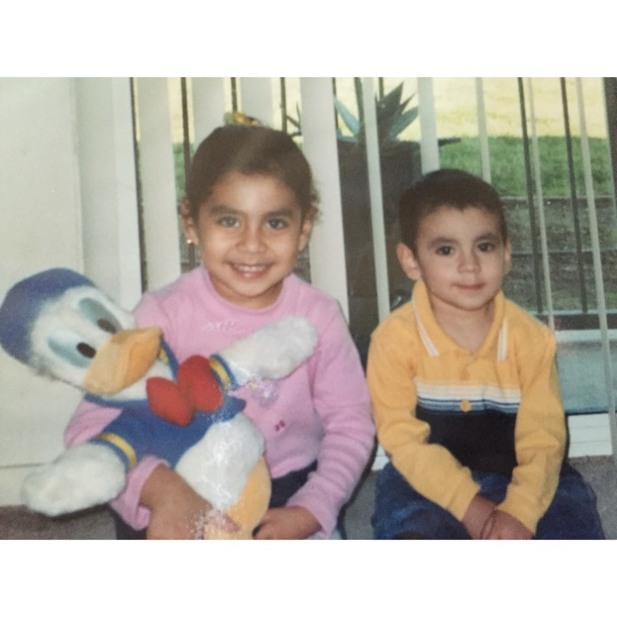
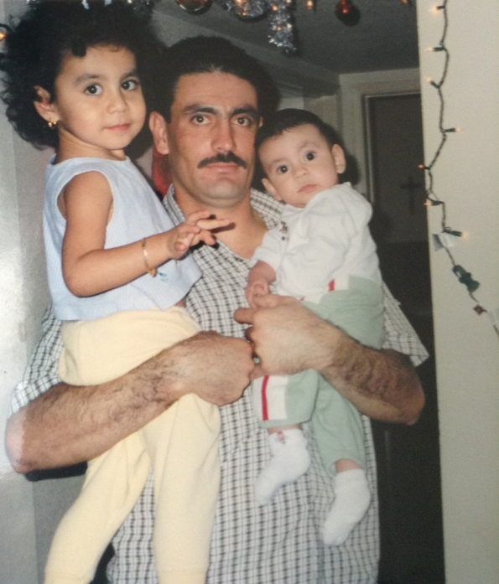
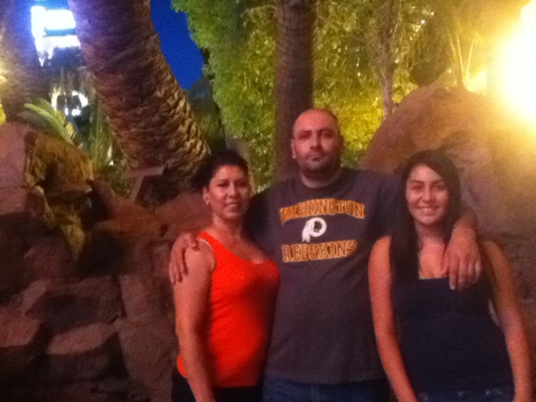
About Me
Daughter of Veronica Lara and Irineo Castaneda
Oldest child (1 younger brother)
Baking is my stress reliever
Coffee addict

Slide 3
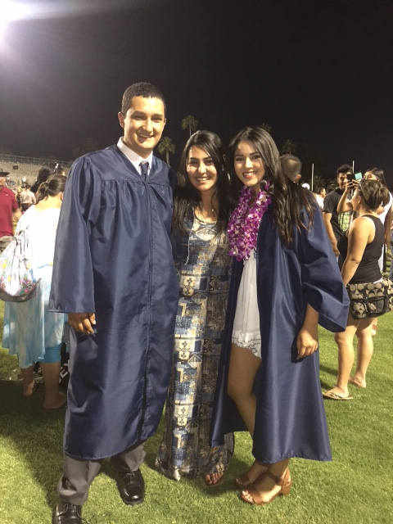
Personal Challenges
Financial issues
Low budget
Emotionally unstable
Overthink a lot
Anxiety
Overcoming my anxiety
Journals
Talking with a family member

Slide 4
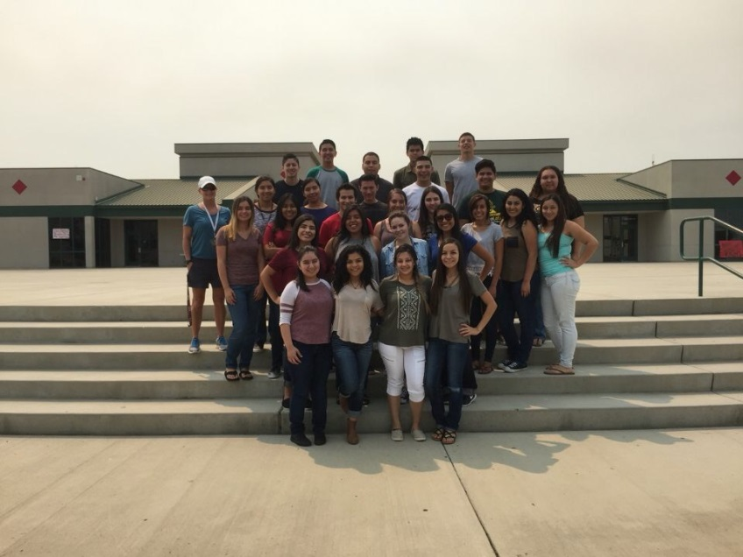
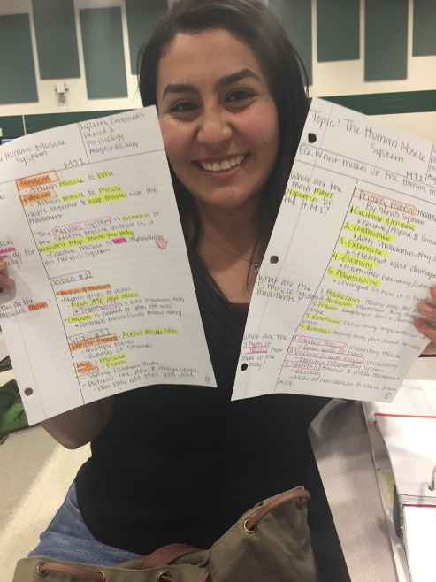
High School Experience
AVID – Sophomore year
College was my top priority (adjustment)
TRiO Program - attended for 1 year
Visit colleges
Bundled up with AVID
Independent learner

Slide 5
Pathway: Medical Services
Helping people
One step closer to become a part-time CNA
help me become certified in the nursing field
What is expected
Patience
Kind-hearted

Slide 6
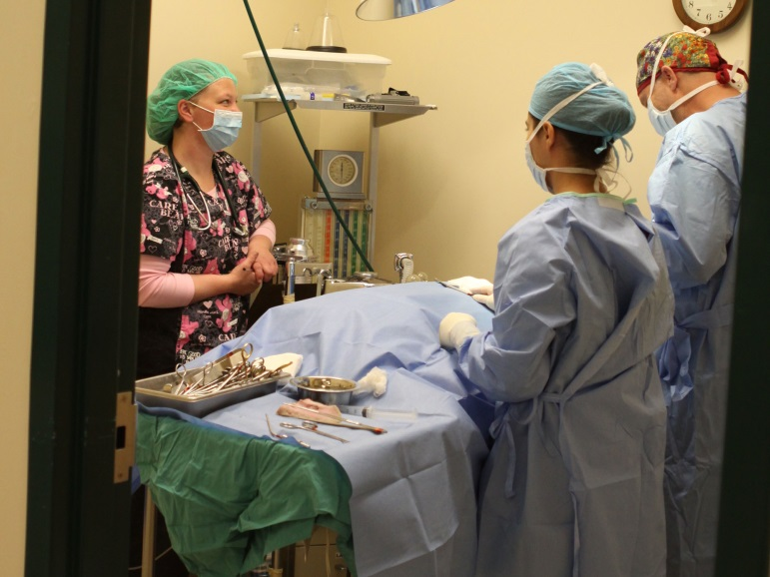
Job Shadow: Orthopedic Surgeon Nurse Assistant
Marisol Hurtado – Neurology Center in Porterville, CA
Multitasking
Memorize codes (ICD10)
Not a flexible position

Slide 7
Post-High School Plans
Support
FAFSA
Scholarships
Mother & Nina
Applied to:
CSU Sacramento
CSU Fullerton
CSU Fresno
CSU San Diego
Short-term goal: Graduate with Bachelors & find a part-time job
Long-term goal: Become a registered nurse

Slide 8
Performance Based System
Deadlines are crucial, so get everything done ahead of time
Be determined
Helps you realize how important independence is
LEARN TO MANAGE YOUR TIME WISLEY!

Slide 9
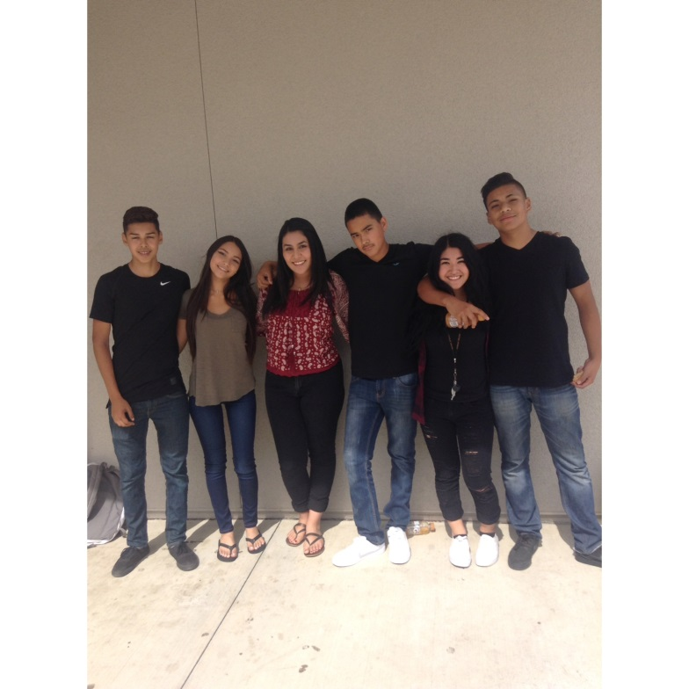
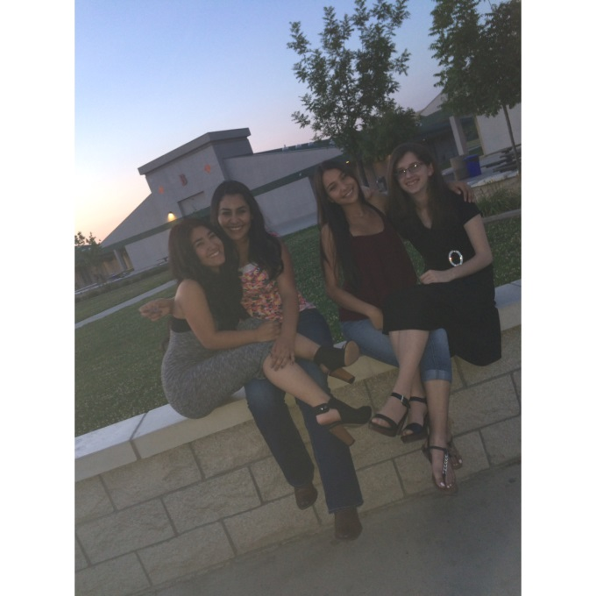
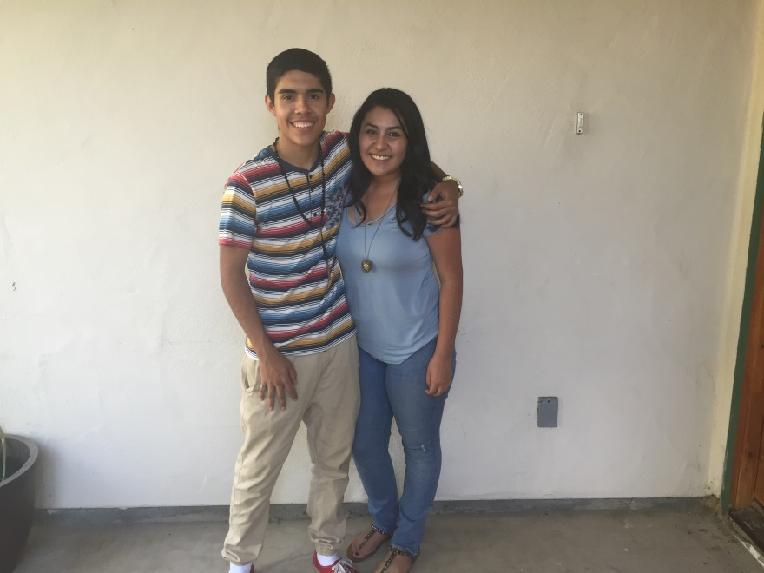
Leaving LHS
Gained networking skills
Be independent
Make mistakes

Slide 10
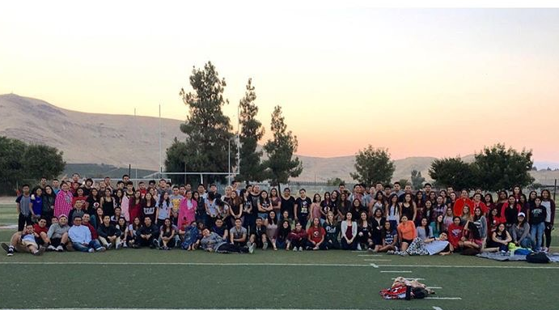
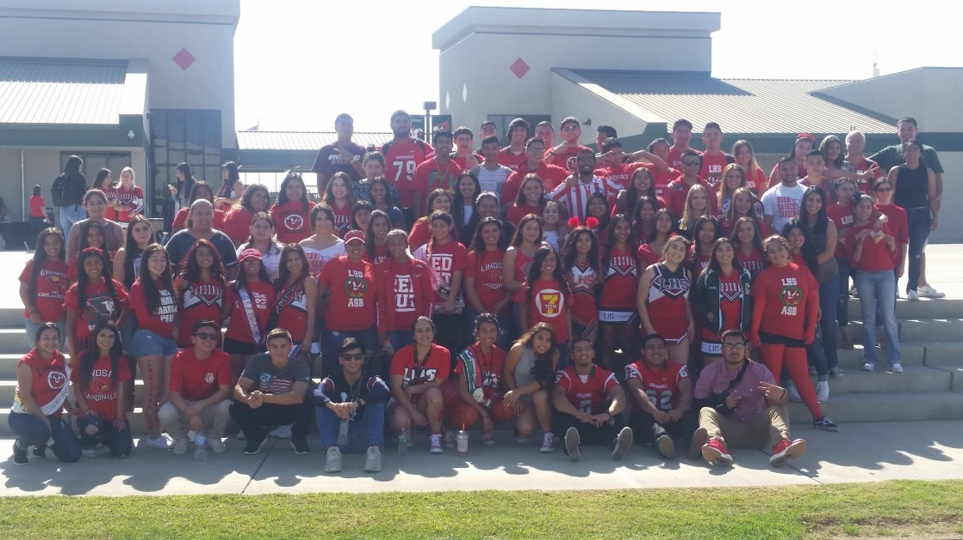
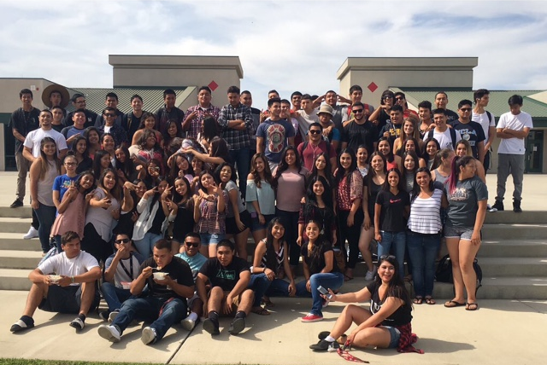
Senior Sunrise
REDOUT Day
Ending of Junior year

Slide 11
THANK YOU FOR YOUR TIME! Questions?

